Slide 1


The application of ergonomics in product design
Kuznetsov A.A.

Slide 2

During this presentation, you will learn about:
What is ergonomics
What is product design
Importance of ergonomic products
Ergonomic product development
Kuznetsov A.A.

Slide 3
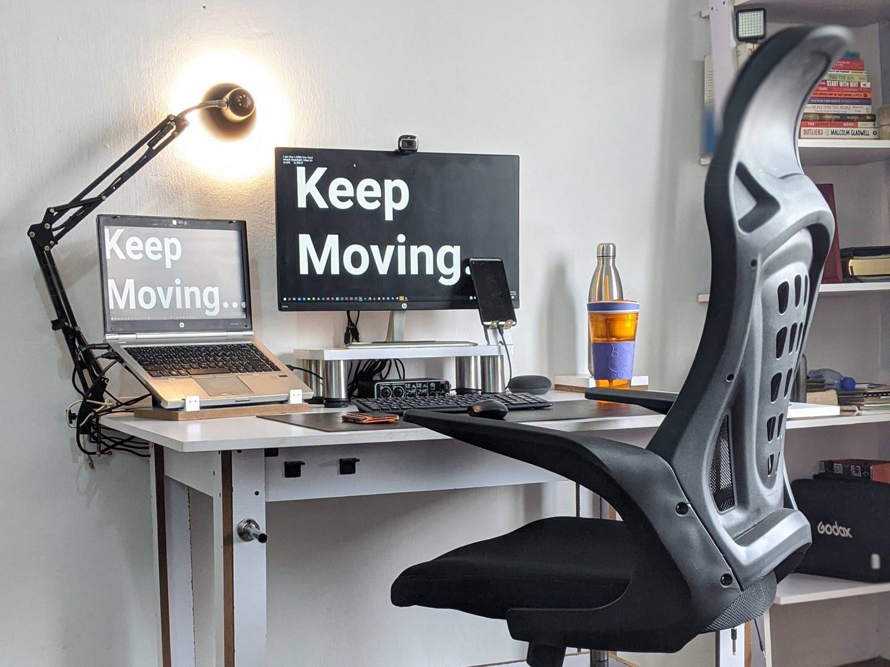
What is Ergonomics?
Ergonomics is the study of the interaction between humans and system elements with the goal of increasing efficiency and compatibility.
Ergonomic principles can be applied to products used in business and personal settings.
Ergonomic products are any goods designed to increase ease of use and reduce injuries.
Kuznetsov A.A.

Slide 4
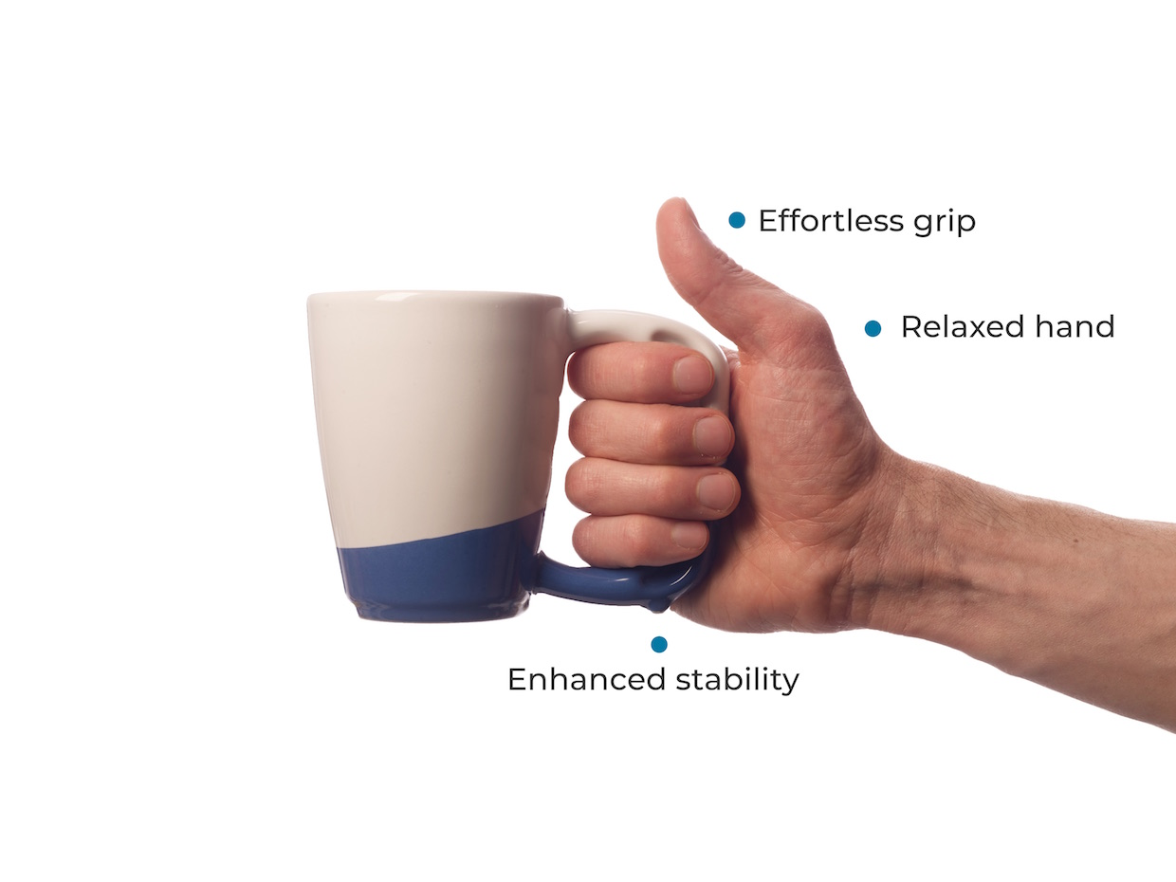
Importance of ergonomic products
Ergonomic products are all around us. Starting with toothbrush and ending with orthopedic bed.
Nowadays there is strong obsession with ergonomic products because they make our life more comfortable! Companies also have a goal to prevent injures on workplaces and increase efficiency of workers due to comfort.
Kuznetsov A.A.

Slide 5
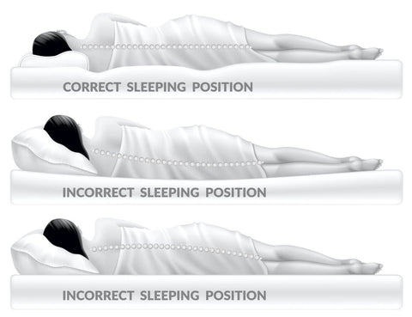
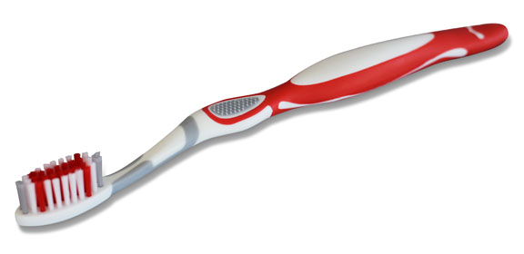
Importance of ergonomic products
Ergonomic toothbrush
Comfortable grip
The brush has different stiffness and fullness for better cleaning and access to difficult parts
Kuznetsov A.A.
Example of ergonomic mattress

Slide 6
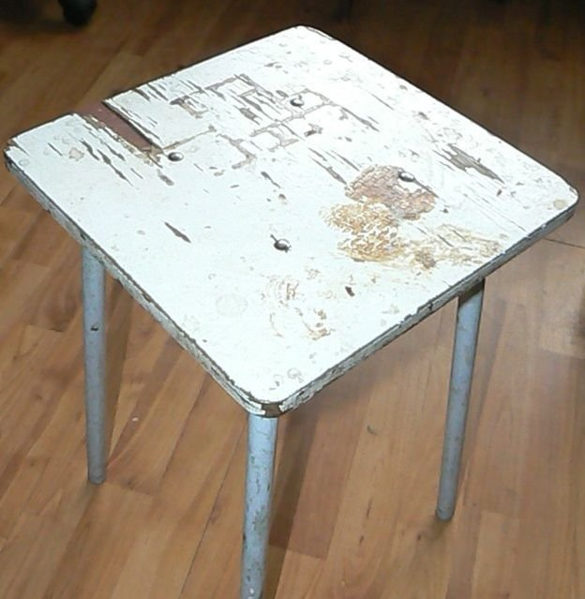
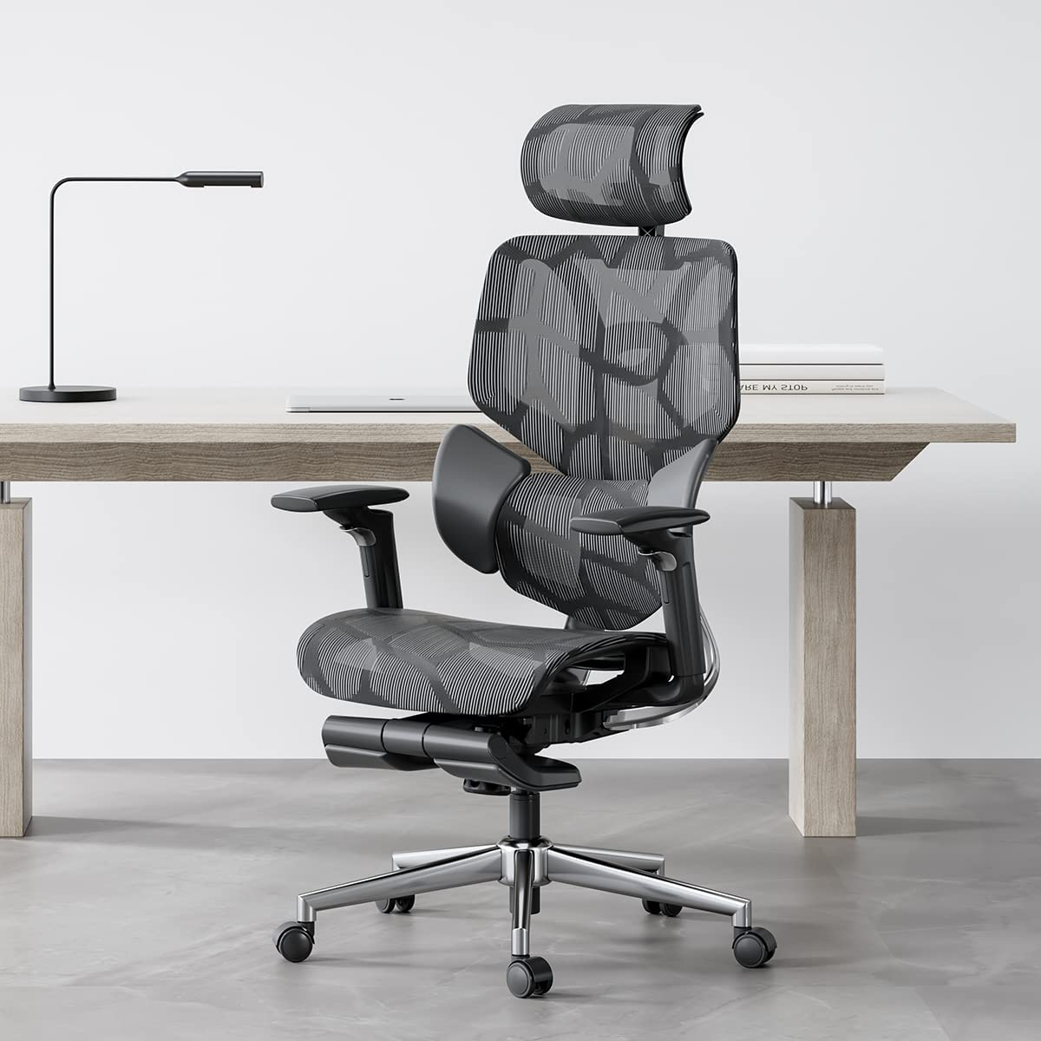
Product design
Ergonomics involves designing the workplace to fit the needs of the worker rather than trying to make the worker adjust to the workplace.
So, ergonomically designed products made by people’s experience of using products and their comfort!
Kuznetsov A.A.

Slide 7
Thank you for your attention!
Kuznetsov A.A.

